Slide 1
Food adulteration
Food is one of the basic needs of all living organisms that are consumed for day-to-day activities. Food contains a variety of essential minerals and nutrients such as carbohydrates, water, lipids, and proteins that animals, including humans, can consume or drink for nutrition or pleasure.
Increase population
Need more food
Resources are limited
Food adulteration
Why we need Food adulteration?
Practised as a part of the business strategy.
An imitation of some other food substance.
Lack of knowledge of proper food consumption.
To increase the quantity of food production and sales.
Increased food demand for a rapidly growing population.
To make maximum profit from food items by fewer investments.
What is the Food adulteration?
Food Adulteration can be defined as the practice of adulterating food or contamination of food materials by adding a few substances, which are collectively called adulterants.

Slide 2
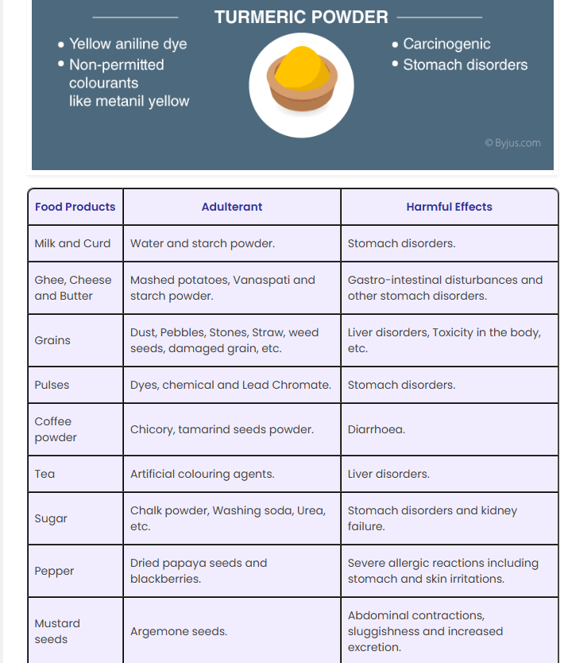
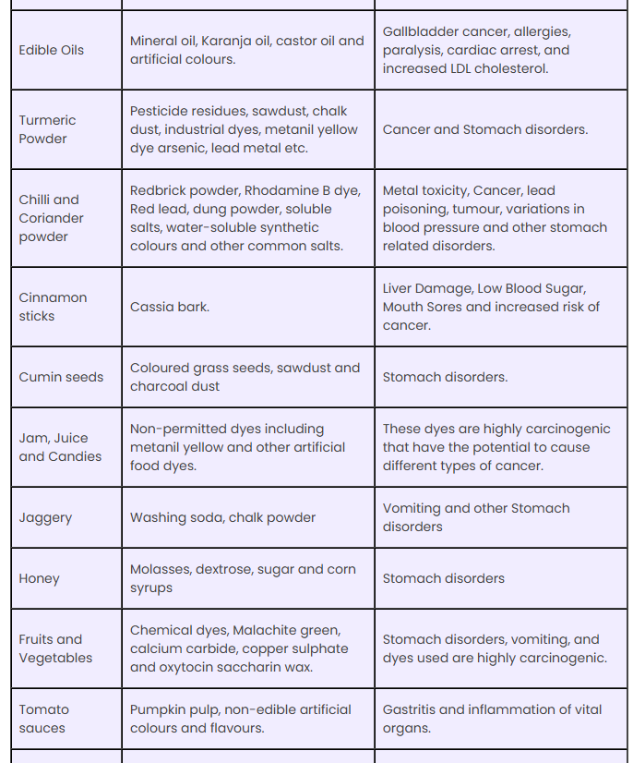
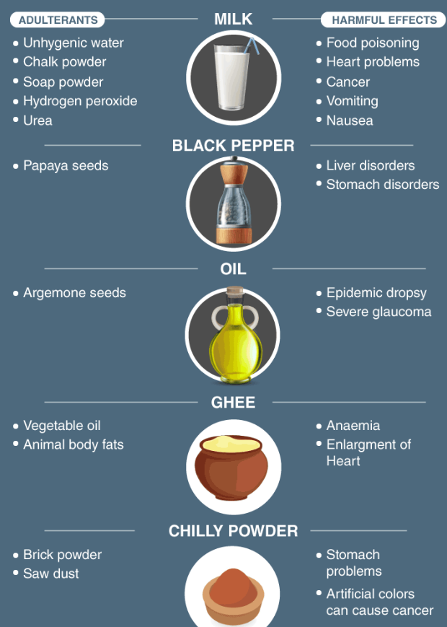
Adulterants in Food

Slide 3
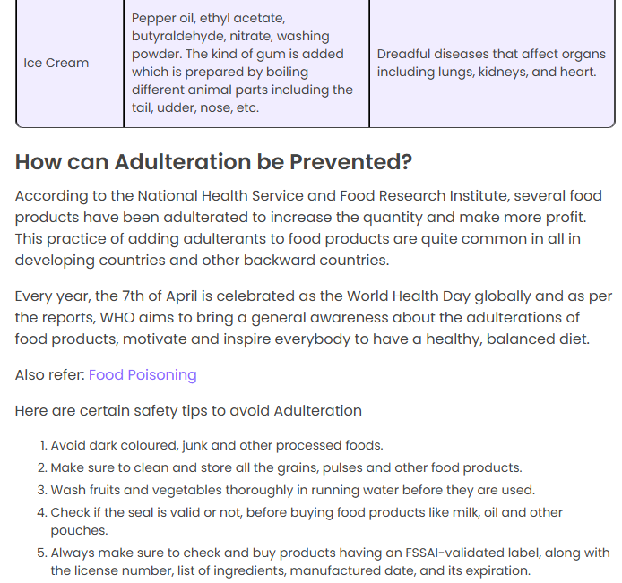
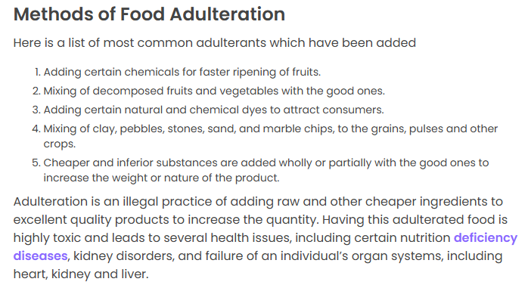

Slide 4
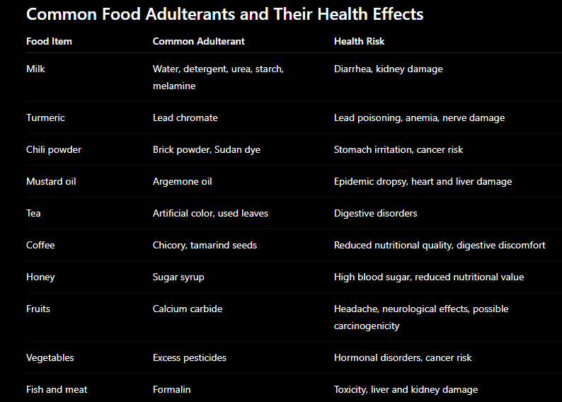
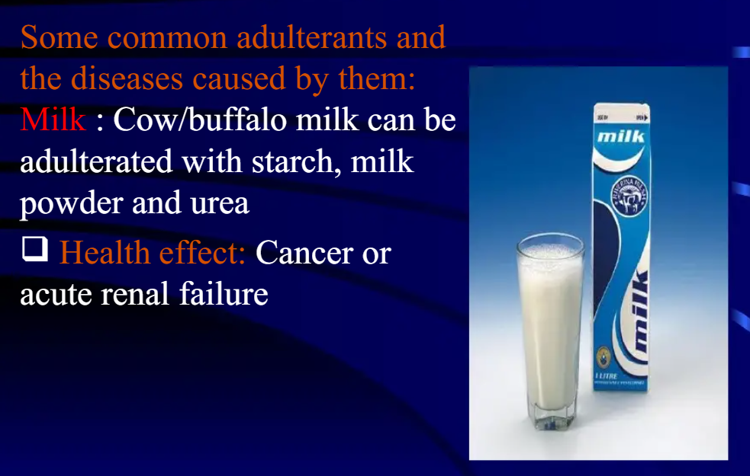
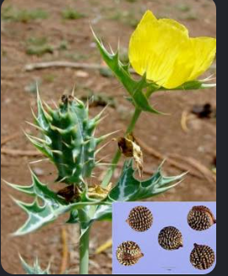
Argemone mexicana

Slide 5
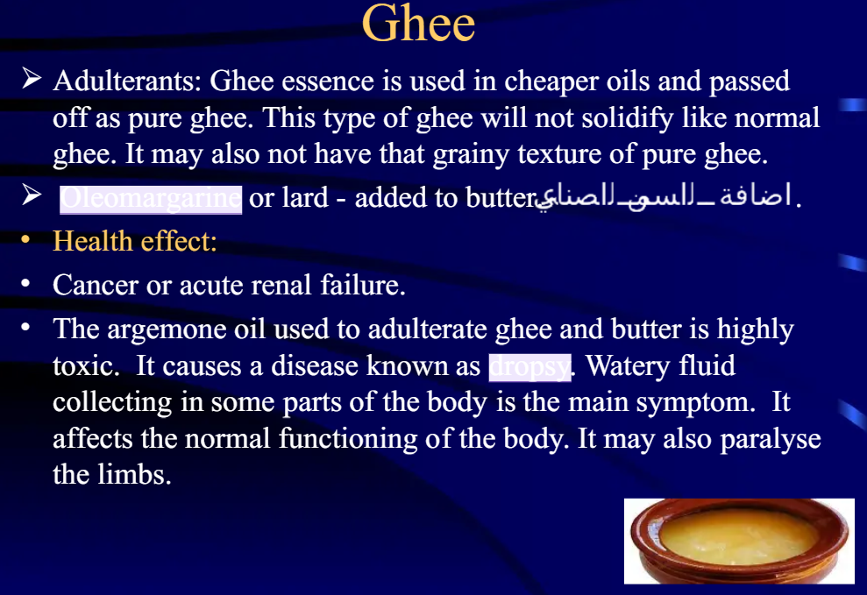
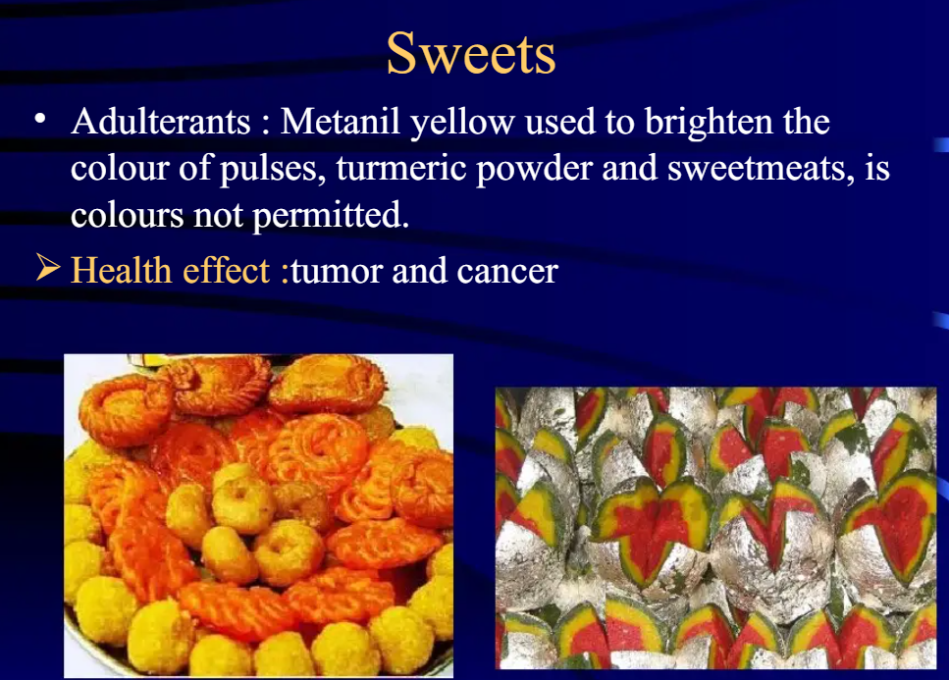

Slide 6
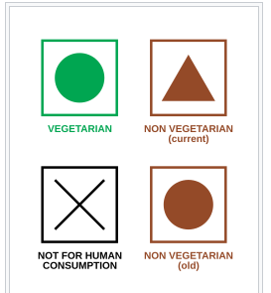
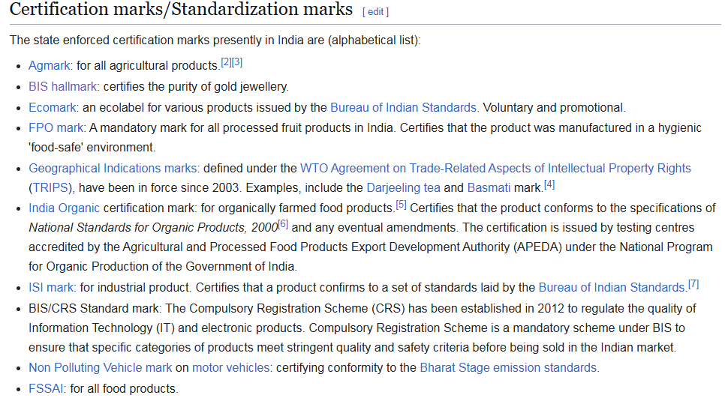
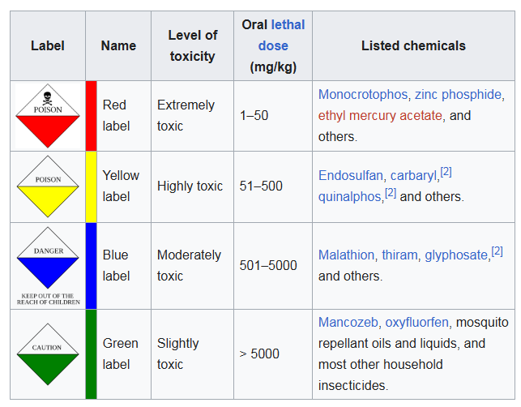

Slide 7
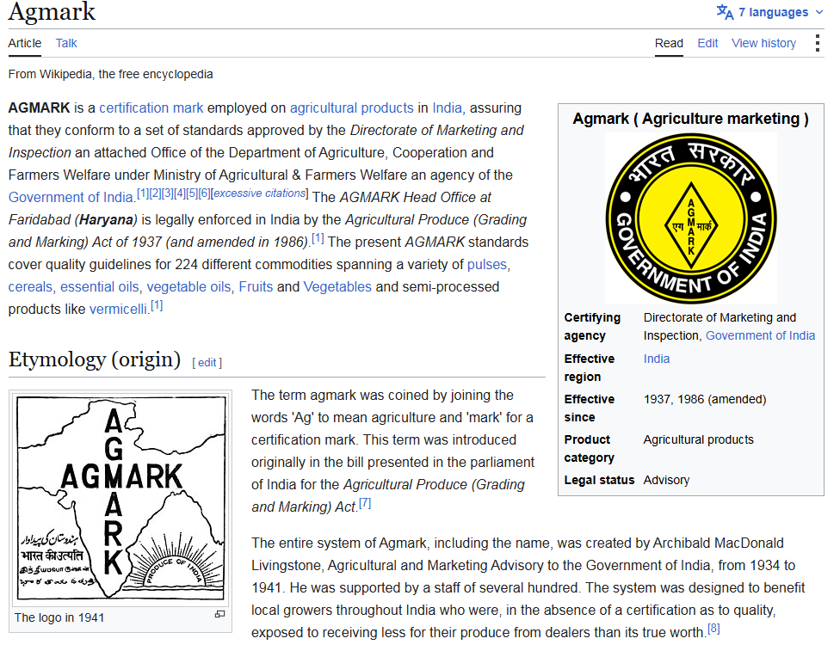
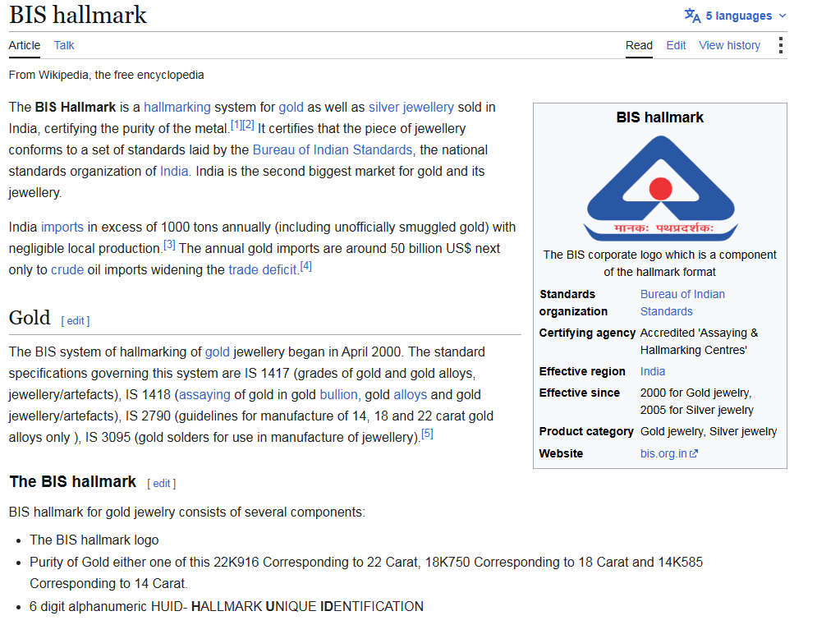

Slide 8
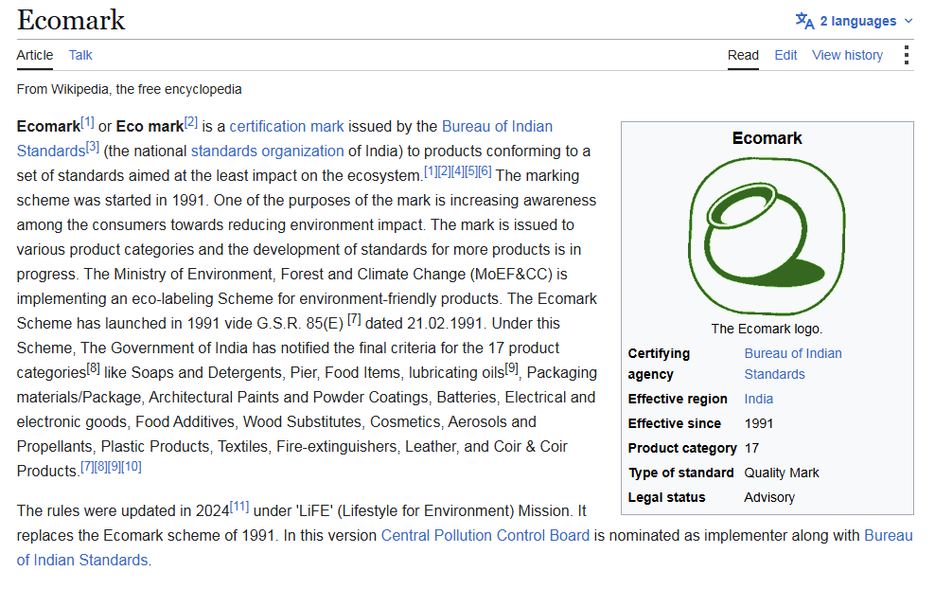
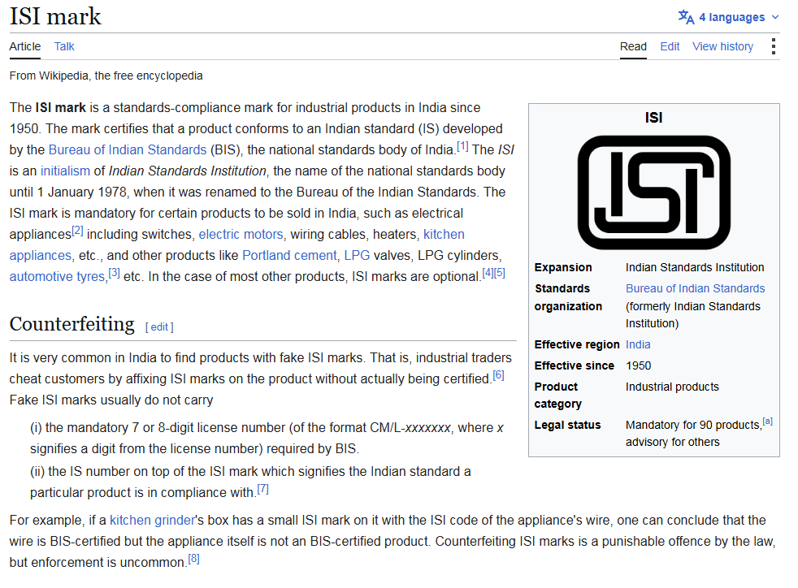
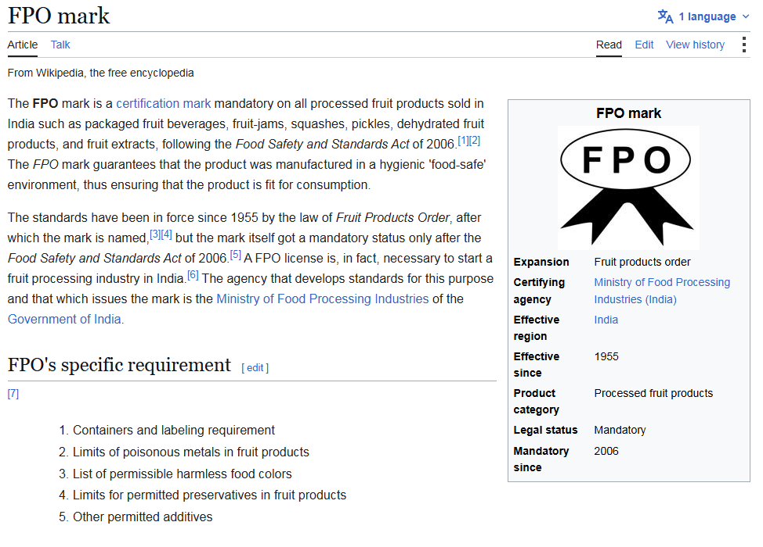
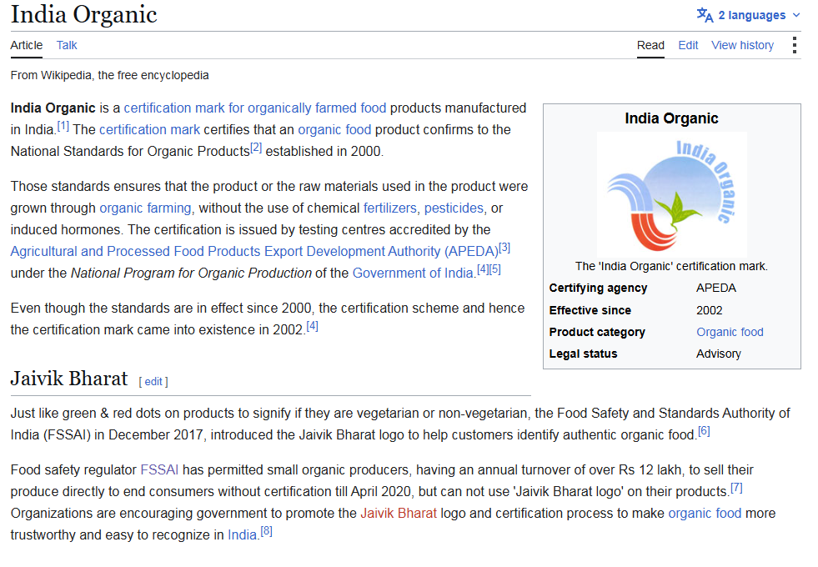

Slide 9
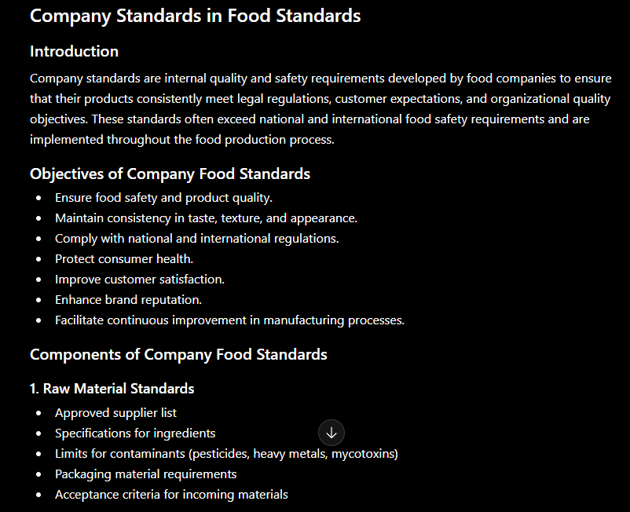
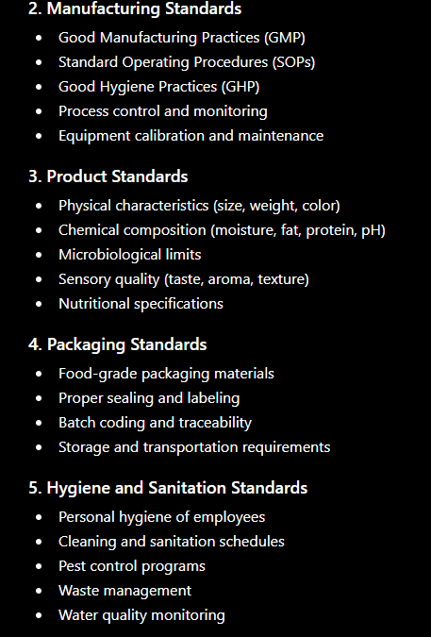

Slide 10
